Slide 1


DATA WRANGLING IN EXCEL WITH POWER QUERY

Slide 2
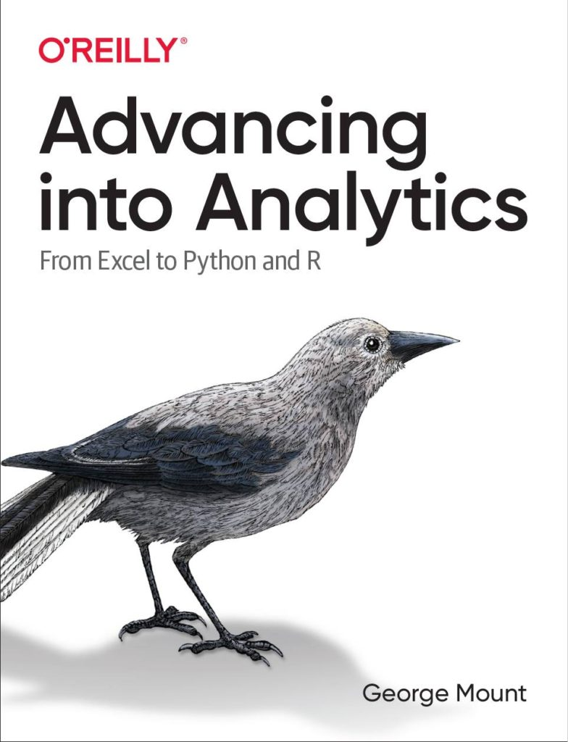



Hi, I’m George

Slide 3

OBJECTIVES
Load data from Excel workbooks and csv files into Power Query
Perform common data wrangling and cleaning tasks
Combine data from multiple sources
First Steps with Power Query for Microsoft Excel

Slide 4
FOLLOWING ALONG
Each section is a sub-folder
Demos = follow along with me
Drills = try it yourself
Refresh your memory with the demo notes
First Steps with Power Query for Microsoft Excel
Notes:
This is an Excel class, so we won’t be looking at PowerPoint the whole time – to follow along, you will see that all assets are divided by section.
Some of our Excel time will be Demos – for this I will be walking through some procedure in Excel.
If you need any datasets they will be included in each sub-folder.
Then there may be a Drill where you will work on it for yourself during some specified period of time.
I have provided written notes/instructions about the Demos which you can refer to while working on the Drills.

Slide 5
1. POWER QUERY AS EXCEL’S ETL TOOL
Notes:
One thing you’ll see that’s interesting about Power Query is that is has brought a lot of best practices in IT into Excel, one of those being the “extract, transform and load” methodology. So, I want take a brief pulse check here, is this a term you have heard of before? And honestly if you don’t, that’s why you are here.

Slide 6

What the @%&! is ETL?
“A properly designed ETL system extracts data from the source systems, enforces data quality and consistency standards, conforms data so that separate sources can be used together, and finally delivers data in a presentation-ready format so that application developers can build applications and end users can make decisions.”
-- (where else but) Wikipedia
Notes:
Now I’m going to be very scientific here and go to Wikipedia to explain how extract, transform, load or ETL methodologies work.

Slide 7








1. EXTRACT
2. TRANSFORM
3. LOAD
Notes:
So, you can see ETL achieves quite a few purposes, and as the name implies it works in three steps:
- First, you want to extract the information from some outside source, this can be anything from a database to a web page.
- Then, you want to transform it. This could be cleaning the data, filtering it, checking for assumptions, you get the idea.
- Finally, loading the data, this places it in a format that is accessible for end users to work with.
https://unsplash.com/photos/QUHlPs4y8PQ
https://pixabay.com/photos/tee-tea-bags-teas-drink-herbal-tea-1252397/
https://pixabay.com/photos/construction-worker-welding-welder-1717893/
https://pixabay.com/photos/gift-box-gifts-packaging-box-2458012/

Slide 8

Power Query & Excel Myth-busting
https://giphy.com/gifs/mythbusters-gif-qVuWpc7MxvGz6
Notes:
As I mentioned, ETL is all over the IT landscape and is considered a best practice when you are working with large amounts of disparate data that need to be “fit for general office consumption.” It’s not just an Excel thing, and in fact this is a pretty disruptive tool to have in Excel, and it really busts a lot of the myths about what Excel can and can’t be which I would like to cover right now.

Slide 9

1. “EXCEL IS NOT REPRODUCIBLE”
Notes:
https://pixabay.com/photos/laboratory-analysis-chemistry-2815641/
Now, the idea of reproducibility is that, the process of getting to some output is fully transparent and it’s possible to walk through each step of the process and get the same result at the end. A lot of typical Excel reporting is not fully reproducible, for example consider a report that depends on you deleting columns A through C to work. Now, if I was going into that final report to understand how it was built, there would really be no way for me to know that, right? On the other hand, a fully reproducible report would show me that, and ideally I’d just click a button and it would do it for me.
In data work, reproducibility is often achieved by powering an analysis with code, so that you can indeed run a script and watch the results emerge one line at a time. Now, the nice thing about Power Query is that it is a code-driven process, so it is reproducible. So does this mean you need to learn how to code in this class? Not necessarily right now. For everyday data cleaning processes, we can use menu-driven options, that will produce code in a Microsoft computer language called M, and now our data-cleaning steps are fully reproducible, in Excel, with no code needed. So that is really cool and a huge myth busted.

Slide 10

2. “EXCEL ONLY DOES STRUCTURED DATA”
Notes:
https://pixabay.com/illustrations/grid-isolation-table-lamp-beetle-2088884/
This is the type of data that in fairness we are more used to working with in classic Excel, data that comes in a nice rectangular shape, usually coming from an Excel workbook or csv file. If the data were in a so-called “unstructured” format, such as song lyrics or a website structure, good luck with using Excel for that.
Come over to Power Query and there is quite an expanded range of possibilities for where data can come from [list on the next page]

Slide 11
Access
.txt and .csv files
SQL Server & other relational databases
XML, HTML & Web data
SharePoint
Hadoop
oData
Combinations of the above…
Notes:
All these types of data and more are fair game to be loaded into Power Query. Where things get really interesting is you are able to combine data from these disparate sources into one consumable data source.

Slide 12

3. “EXCEL CAN’T HANDLE LARGE DATASETS”
Notes:
And that’s the last myth I want to bust here, is that Excel can’t handle large datasets. Now, with “classical Excel” this was probably true, that Excel just couldn’t handle some of those bigger datasets that a lot of data analysts are working with these days, but that’s just not true when you are using Power Query [example on next slide]
https://pixabay.com/photos/amphibian-turtle-animal-armor-blur-1850190/

Slide 13
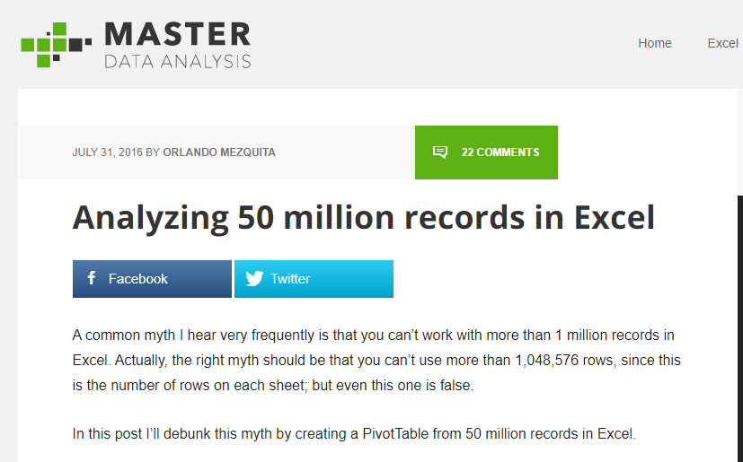
https://www.masterdataanalysis.com/ms-excel/analyzing-50-million-records-excel/
Notes:
Here is an example of that, a blog post about analyzing 50 million records using Excel. 50 million is pretty significant for most anyone, and Excel could handle it, so dismissing Excel out of hand on account of performance is just not as true anymore with Power Query.

Slide 14
What did we do before Power Query?
File: wholesale-customers.xlsx
How would you make this data “PivotTable-ready?”
Notes:
Now you are hyped up Power Query, I think you are going to love it and it will be hard for you to remember the days when you didn’t have it. So let’s think about what we would do without Power Query.

Slide 15
QUESTIONS?

Slide 16
2. WHAT MAKES DATA TIDY?
Notes:
An example that should sound familiar to you as a data analyst follows on the next slide.

Slide 17

Notes:
It’s not even like a box of chocolates, because we KNOW we are going to get something dirty & unfit for consumption.
If you do anything with data you know how much time is spent cleaning it. You never know what is going to come through that attachment.
And Power Query will indeed help you automate some of these process that you go through every week, such as deleting columns, sorting rows, etc, and you won’t necessarily have to write code like you would have in VBA. But what Power Query can’t tell you is how the data should be shaped. You should have some “attack plan” when you encounter a dataset so that you are “beginning with the end in mind,” that is, a dataset that will be easy to analyze.

Slide 18
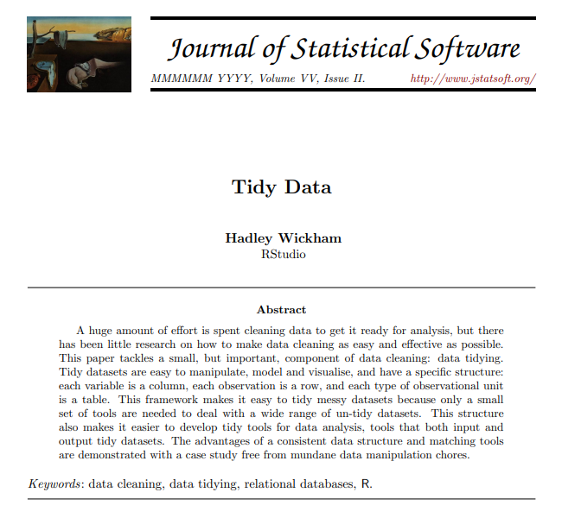
TIDY’S ORIGINS
http://vita.had.co.nz/papers/tidy-data.pdf
Notes:
And the paradigm we will borrow from to do that comes from Hadley Wickham, a statistician and prolific author of R packages. Wickham wrote a paper called Tidy Data that gave some pointers for how to clean datasets so that they are optimized for analysis.
I have included a copy of this paper in the repo, you can also download it at the link.

Slide 19
OBSERVATIONS AND VARIABLES
Observation: The unit that was measured
Variable: What was measured
Notes:
It’s really pretty brilliant and like a lot of brilliant ideas, it’s rather simple: We want to break our data into two categories, observations and variables. There are also sometimes called dimensions and measures. A good way to think about this is that observations are going to be fixed by the design of our data collection, and variables will be measured during the course of the experiment.
So, if you are measuring the heights of individuals, each person would be an observation, and height would be the variable.
It’s one of those concepts that “you know when you see,” so let’s practice a little more.

Slide 20
DRILL
Which attributes are observations, and which are variables?
Attribute | Observation or variable?
Store #
Month
Sales
Notes:
Which is which? [Answers on next slide]

Slide 21
DRILL
Which attributes are observations, and which are variables?
Attribute | Observation or variable?
Store # | Observation
Month | Observation
Sales | Variable
Notes:
One thing to consider here is that observations do not necessarily have to be “letters,” for example Month could be represented as 1,2,3 or Jan,Feb,Mar.
So, what does this distinction have to do with data cleaning? [next slide]

Slide 22
WHAT MAKES DATA TIDY?
Notes:
We want to have our data organized so that each variable is its own column, and each observation is its own row. So, if you remember our wholesale sales dataset, Category would have been an observation, and Sales a variable. We should have had Sales as one column, and then Category went down the rows.
There is one more principle of “tidy” data that we will not explore, it gets into concepts related to database normalization, but for our purposes thinking about having every variable in its own column is going to be of tremendous help.
We should also remember that every cell should be some populated intersection of an observation/variable! That means that merged cells, unrepeated fields, even totals are not going to be tidy for us. We want it in this form to analyze.
And you can get a sense of some of these pain points if you have ever built a PivotTable, it does not take kindly to some of these cosmetic tweaks that are often made to datasets. To practice what some of those tweaks are and what we would want to do to get the dataset to tidy, a couple of drills follow.

Slide 23
DRILL
How would we tidy this dataset?
(Don’t do, just think)
Notes:
What if you were given a dataset like this, what would you do with it so you could actually analyze it?
Note that you don’t actually have to re-shape this data, just think through what changes you would want to make.

Slide 24
SOLUTION
Notes:
A few things, right? First, get rid of all the excess rows and columns, unmerge and rotate the Model headers, move the Regions into a new column. You’ll see that this data moves from being “short and wide” to “tall and narrow” and that is one of those colloquial hallmarks of what happens when you make a dataset easier to analyze.
Let’s try one more.

Slide 25
DRILL
How would we tidy this dataset?
(Don’t do, just think)
Notes:
Here’s another one, how would you clean it up? Don’t actually do it, just think through it.

Slide 26
SOLUTION
Notes:
Same idea here, right? We have a “tall and narrow” dataset now.
To the uninitiated this does not look like a very helpful dataset, because look how many things are repeating, right! I mean we had such a nice little compact table before and now it’s this really long table.
However for the purposes of actually analyzing this data, this is a preferred state, because now we are free to re-summarize and re-aggregate as each observation now makes its own row, and each variable is its own column.

Slide 27
QUESTIONS?
Notes:
This all may seem like a lot of wind-up but it’s easy to over-emphasize the technology. It can’t tell us what to do. So before we start to use Power Query to clean data, we should have an idea of what clean data actually is!

Slide 28
Data profiling with Power Query

Slide 29
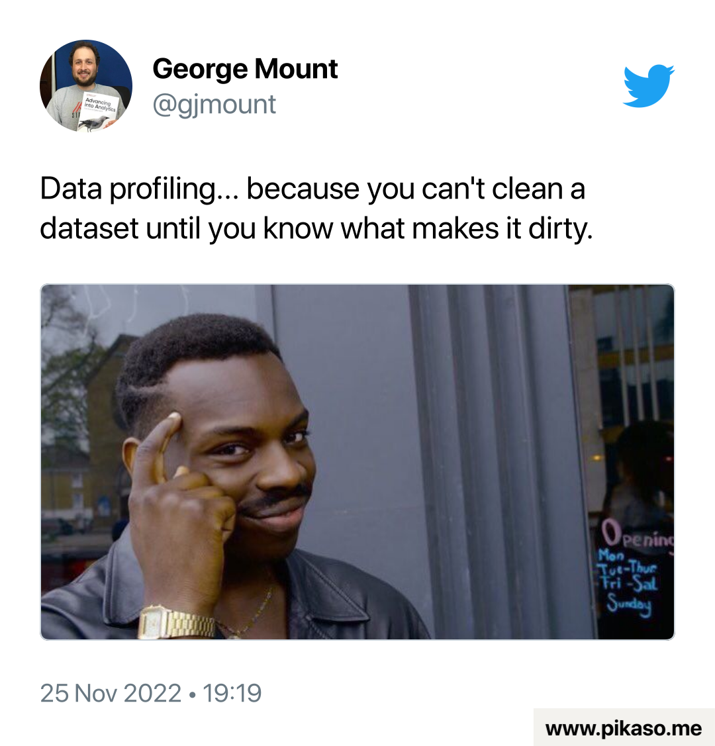
Data profiling: a 30K-foot view of the data
Does the dataset include everything?
How accurate is the data?
If the data is kept in Excel, are there any formula errors that could harm future analyses?
Is it clear what variable & observations are being measured?
Notes:
Now we are used to structured data but unstructured data is coming into vogue and there are ways to use them together…

Slide 30
Data prep & profiling with Power Query
File: computers.xlsx
Profiling the data for potential issues
Adding an index column for slicing and dicing
Notes:
Now you are hyped up Power Query, I think you are going to love it and it will be hard for you to remember the days when you didn’t have it. So let’s think about what we would do without Power Query.

Slide 31
3. FIRST STEPS IN POWER QUERY
Notes:
Let’s finally get into Power Query! We won’t really clean or transform anything here, but we will see an awesome built-in Power Query tool for exploratory data analysis.

Slide 32
DEMO
File: star.xlsx
Load into Power Query
Explore via Data Preview
Refer to demo notes
Notes:
Open this file. We will get into Power Query now.

Slide 33
DRILL
File: computers.xlsx
Load into Power Query
Explore via Data Preview
Don’t forget the Demo Notes if you get stuck
Notes:
Now do the same for the computers file.
Reminder that if you don’t remember how I did something in a demo, you can refer to the demo notes for written instructions.

Slide 34
QUESTIONS?
Notes:
Any questions on descriptive statistics?

Slide 35
4. TRANSFORMING ROWS IN POWER QUERY
Notes:
In this section we will do some common row-wise data transformation such as sorting, removing duplicates, filtering, filling and grouping a table

Slide 36
DEMO
File: office-rsvps.xlsx
Notes:
Any questions on descriptive statistics?

Slide 37
DEMO
File: regional-sales.xlsx
Notes:
Any questions on descriptive statistics?

Slide 38
DRILL
File: state-populations.xlsx
Worksheet: states
Name the query State populations.
Remove the United States row from the data.
Fill down blanks on the Region and Division columns
Sort by Population from high to low
Load results into a PivotTable
Worksheet: midwest_cities
1. Convert this data into a table where each city is in its own row.
Notes:
Any questions on descriptive statistics?

Slide 39
QUESTIONS?
Notes:
As you saw with the last solutions one of the best ways to learn is just to go the extra mile with your data sets, ask “what if” and start to play around. I can’t possibly show you all the row-wise operations because it’s really infinite in Power Query so the best thing we can do is with these little case studies where we start to play around with different options and combinations based on what we want to do with the data.

Slide 40
5. TRANSFORMING COLUMNS IN POWER QUERY, PART I
Notes:
Now, we’ve worked on making row-wise transformations, let’s focus on the columns. We may want to do things like reformat a column, change its data type or split is based on some delimiter.

Slide 41
DEMO
File: dvdrentals.xlsx
Notes:
Let’s practice on this DVD rentals dataset, this comes directly from this website, and we just want to do some various things to this data, so as always let’s do a Data, From Table, and now we are in our Query editor and we can do a few things.

Slide 42
DRILL
File: orders.xlsx
Convert the Date column to Month.
Convert the Account column to proper case.
Split the Opportunity column into three columns:
Vendor
Status
Order Type
Notes:
Any questions on descriptive statistics?

Slide 43
QUESTIONS?
Notes:
Some of what we did you may be familiar with – text to columns, reformatting a column, but actually changing a data type is different – we aren’t just cosmetically changing the data, or parts of the data, in Power Query, we are actually converting its type and that is really a different way of doing things, almost more like what you would do in a database. Pretty cool. Let’s continue with some more sophisticated column-wise transformation.

Slide 44
6. TRANSFORMING COLUMNS IN POWER QUERY, PART II
Notes:
This section will actually be in two parts.

Slide 45
6A. Transforming Columns
Notes:
First we will continue with some column transformations, in particular we will create calculated fields and then un-pivot a table.

Slide 46
DEMO
File: population-densities.xlsx
Notes:
Any questions on descriptive statistics?

Slide 47
DRILL
File: wholesale-customers.xlsx
Tidy this data! (Each variable should have its own column)
Create a field calculating 10% of the sales called Tax
Notes:
Any questions on descriptive statistics?

Slide 48
6B. Appending Tables
Notes:
Next we will start to operate on multiple tables at a time, first by appending two or more tables together, which in some ways is a row-wise operation, but it’s based on columns so I think it still counts ☺

Slide 49
DEMO
Files: oscars_yes.csv, oscars_no.csv
Start with a blank Excel workboook
Notes:
Now we will switch it up a little bit

Slide 50
DRILL
File: hof_inducted.csv, hof_not_inducted.csv
Append these tables
Notes:
Any questions on descriptive statistics?

Slide 51
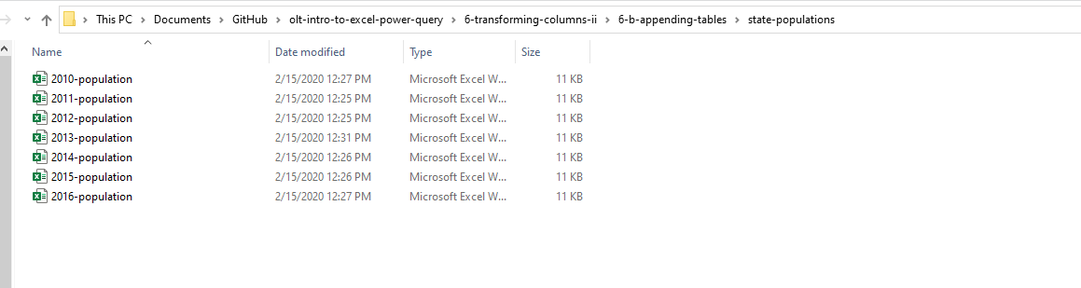
DEMO
Append from a folder of files:
Folder: state-populations

Slide 52
DRILL
baseball folder
This is a download of the csv version of the Lahman baseball database.
See if you can get a table of all files in this folder using Power Query.
In this case we do not want to transform the data, just load a table of the file metadata.
Notes:
This is actually the source data of the hall of fame tables.

Slide 53
QUESTIONS?
Notes:
Any questions on descriptive statistics?

Slide 54
QUESTIONS?
I have one:
Who are these people?
Notes:
It looks like the first two names are Ty Cobb and Babe Ruth but how would I know that for sure? It’s not English? Why are we using these? If you have done a lookup before you may know why. We are going to get a lot more advanced with them

Slide 55
6. VLOOKUP(), MEET JOIN

Slide 56
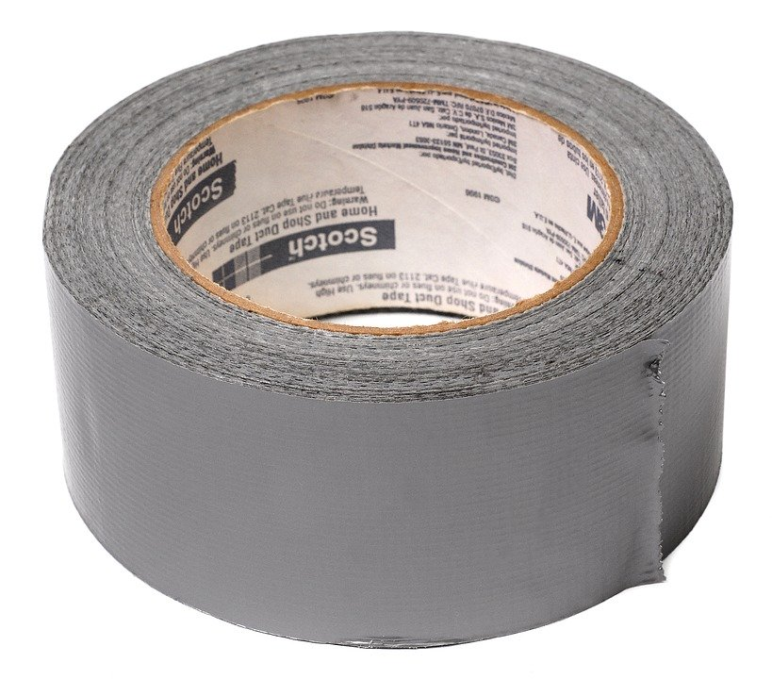

DUCT TAPE, MEET WELDER
VLOOKUP()
JOIN

Slide 57
DEMO
File: flights-and-planes.xlsx (the VLOOKUP way)
Notes:
Any questions on descriptive statistics?

Slide 58
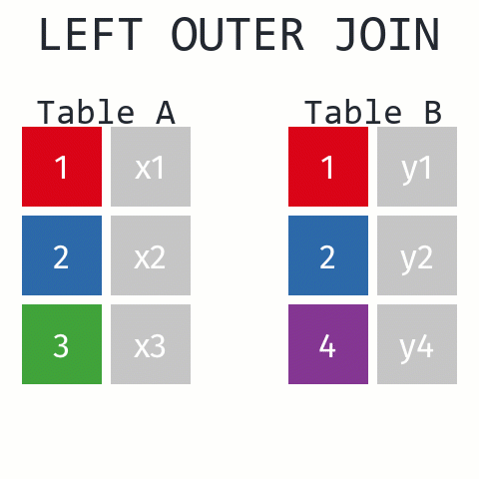
Returns ALL records from Table A and matching records from Table B. Results with no match are null.
https://github.com/gadenbuie/tidyexplain#mutating-joins

Slide 59
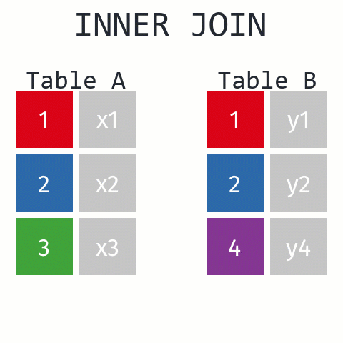
Returns records that have matching values in Tables A and B
https://github.com/gadenbuie/tidyexplain#mutating-joins
Notes:
These are R functions but the idea is the same.

Slide 60
DEMO
File: flights-and-planes.xlsx (the Power Query way)
Notes:
Now, let’s see what happens with our data when we use a join versus a lookup.

Slide 61
DRILL
Files: hof.csv, people-a-thru-m.csv
What is the result of a left outer join of hof on people-a-thru-m?
What about an inner join?
Notes:
Our source data only contains a list of the people with last names A thru M. How will this affect an inner join versus an outer join.

Slide 62
QUESTIONS?
Notes:
Any questions on descriptive statistics?

Slide 63
JOIN Beyond the basics

Slide 64
DATABASE JOIN TYPES
LEFT OUTER
RIGHT OUTER
A
B
A
B
FULL OUTER
A
B
INNER
A
A
LEFT ANTI
RIGHT ANTI
A
B
A
B

Slide 65
DEMO
File: championships-demo.xlsx
Which cities can claim only a baseball or football championship?
Left anti
Right anti
Baseball
Football
Baseball
Football
Notes:
Let’s imagine that our baseball team is the Left table and the Football teams is the Right table. If I only want the records of cities who have a baseball championship I can use a left anti. Vice versa for football cities.

Slide 66
DRILL
File: championships-drill.xlsx
Which cities can claim only a hockey or basketball championship?
Notes:
The illustrations follow on the next slide.

Slide 67
JOINS CAN GET EXOTIC
Cross join
TABLE A
TABLE B
1
2
3
1
2
3
https://www.tutorialgateway.org/sql-cross-join/
Notes:
Let’s look at another type of join that is often not listed as a join type but actually is and that is a cross or Cartesian join.

Slide 68
DEMO
File: office-employees.xlsx
Notes:
Any questions on descriptive statistics?

Slide 69
DRILL
Files: states.xlsx
Create a table to record each state’s bird, flower and capital
Notes:
Any questions on descriptive statistics?

Slide 70
QUESTIONS?
Notes:
Any questions on descriptive statistics?

Slide 71
7. CONCLUSION
Notes:
Thank you everyone for coming today, as you have seen Power Query is a beast. There is so much you can do, it really opens up the doors to not just Excel but the Microsoft BI stack as a whole, so let’s see what I mean here.

Slide 72
What to learn next?
M language
PowerPivot
Power BI
Notes:
As you are going to see, learning Power Query can take you in a lot of different directions, which is pretty mind blowing, because there are just so many ways to go and things to learn these days.
Manipulating the M language: This will let you write things like custom functions. This will also be a good gateway into things like re-using queries and customizing what stuff does.
Power Pivot: This is the data modeling language. So if you wanted to build something like a relational schema inside a workbook, and again this can be with data coming from all types of places, and you can even use Power Query to clean up that data and then Power Pivot to build relational models, pretty cool dynamic duo.
Power BI: This is the dashboarding/reporting/visualization part of the Microsoft BI stack. The cool thing is you’ve got a leg up for learning this, because Power BI also has Power Query!

Slide 73
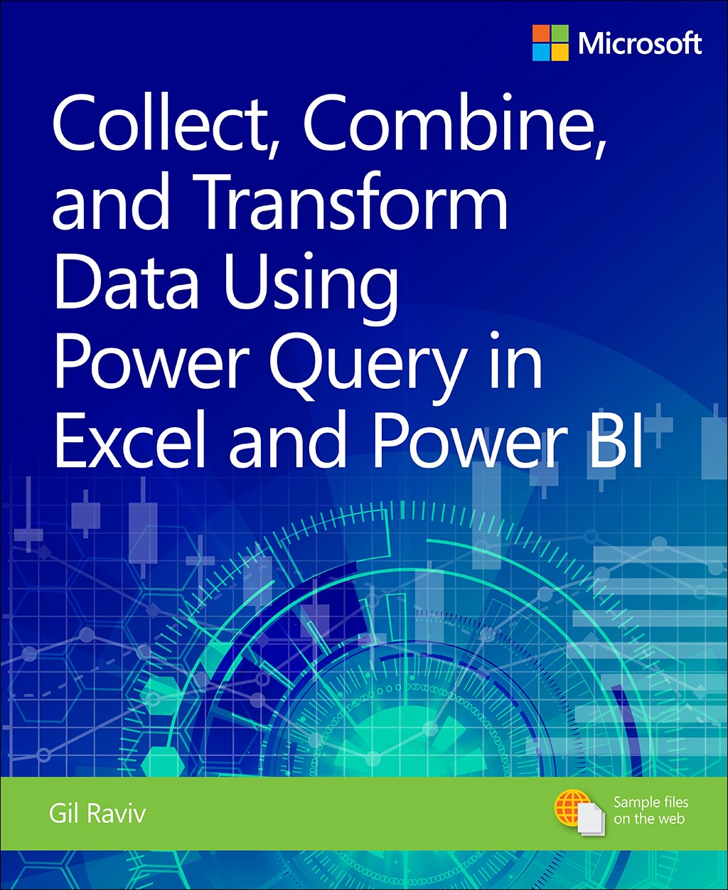
Collect, Combine, and Transform Data Using Power Query in Excel and Power BI, 1st Edition
by Gil Raviv
On O’Reilly Learning at https://learning.oreilly.com/library/view/collect-combine-and/9781509307982/
Human Centered Design • MDLS 2020
Notes:
This one is a real tour de force in pushing your Power Query capabilities, it will also show you Power BI stuff if you are interested in that.

Slide 74
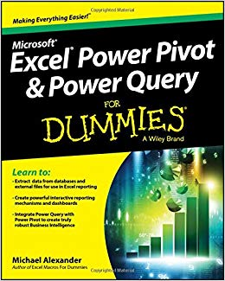
Excel Power Pivot and Power Query For Dummies,
by Mike Alexander
On O’Reilly Learning at https://learning.oreilly.com/library/view/excel-power-pivot/9781119210641/
Human Centered Design • MDLS 2020
Notes:
This one is a little more user friendly, it focuses on Excel and you will also learn about Power Pivot as well.

Slide 75
LET'S TALK
LINKEDIN
linkedin.com/in/gjmount
EMAIL ADDRESS
george@stringfestanalytics.com
WEBSITE
stringfestanalytics.com
GITHUB
github.com/summerofgeorge
Notes:
Thanks for coming! Feel free to contact me anytime, find me on LinkedIn, I also write frequently on this stuff so check out my website too.

Slide 76
QUESTIONS?
Notes:
Any questions on descriptive statistics?

